Slide 1



Control and Automation IC2122 Robotics Lab with VREP
Instructor:
Industrial Centre
The Hong Kong Polytechnic University

Slide 2
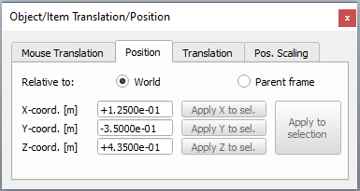
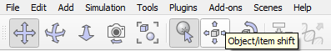
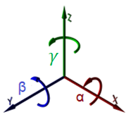
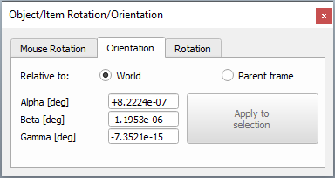
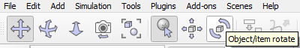

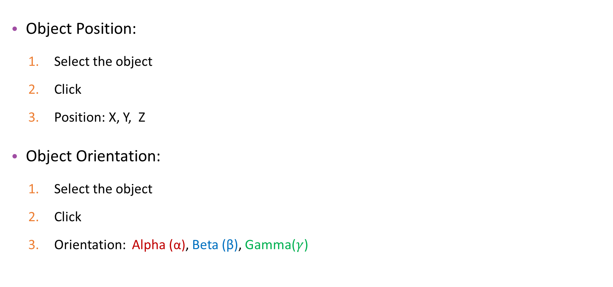
V-REP Tools
Object Position:
Select the object
Click
Position: X, Y, Z
Object Orientation:
Select the object
Click
Orientation: Alpha (α), Beta (β), Gamma($γ$)

Slide 3
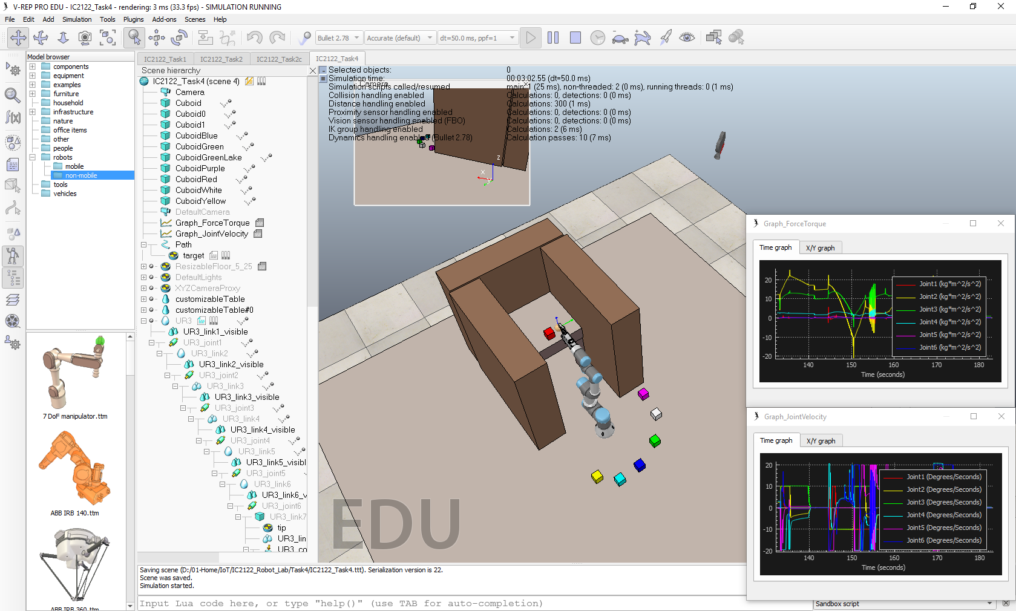
Task 3: Pick and Place

Slide 4
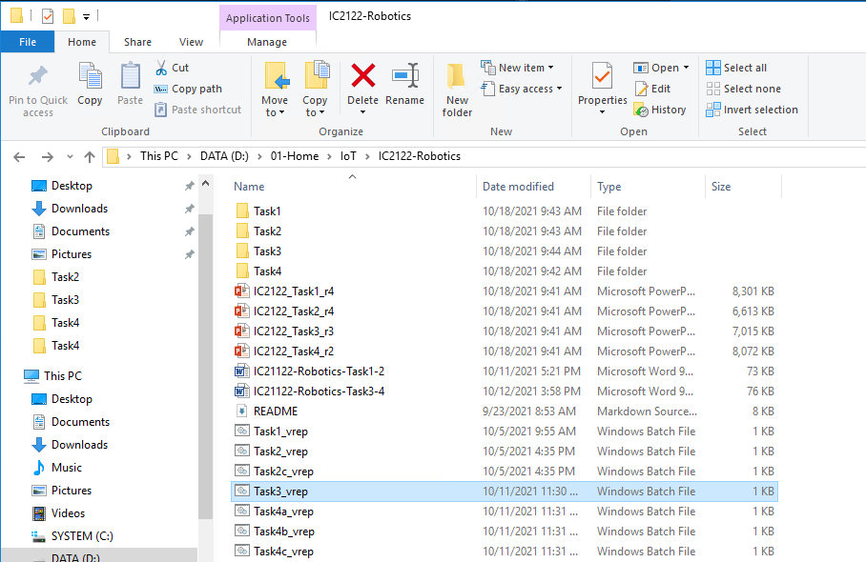
Start-up – V-REP
Start the V-REP (Task3_vrep.bat)
D:\01-Home\IoT\IC2122-Robotics
Double-Click

Slide 5
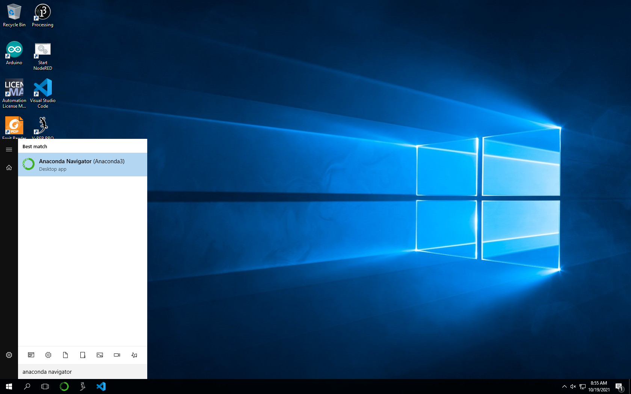
Start-up – Anaconda Navigator
Start the Anaconda Navigator on Taskbar or search Windows
Search Anaconda Navigator and click the icon
OR
Click Anaconda Icon

Slide 6
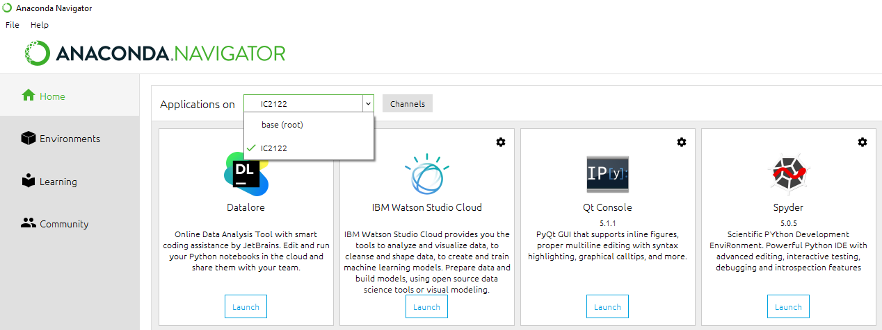
Start-up – Spyder
Launch Spyder
2
1
3
4

Slide 7
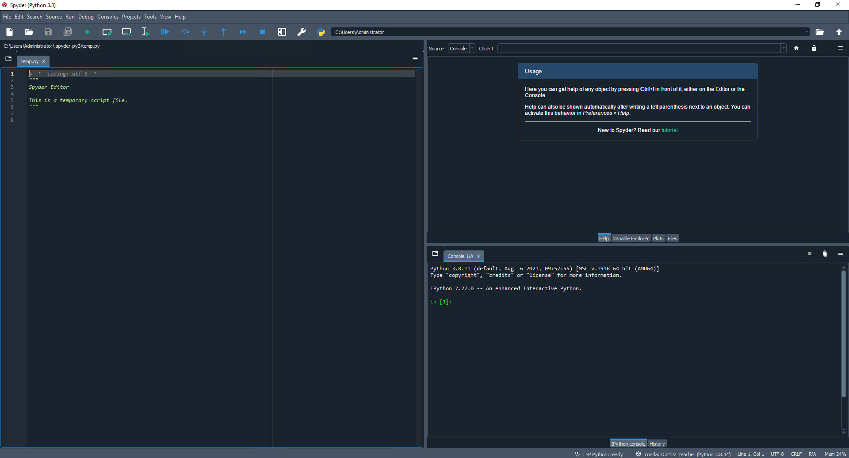
Start-up – Spyder
Toolbar
Help
Editor
IPython Console
Status Bar

Slide 8
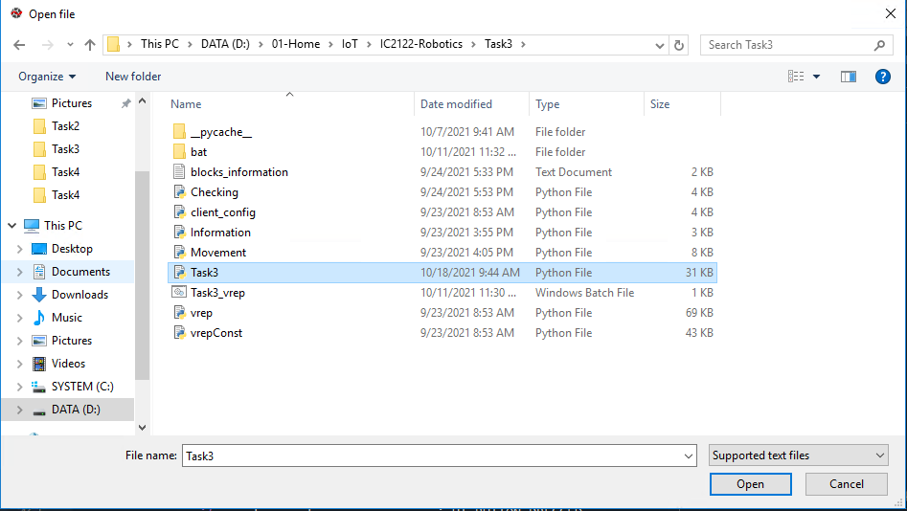
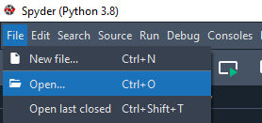

Start-up – Spyder
D:\01-Home\IoT\IC2122-Robotics\Task3
Open Python file at editor
Run the program at Spyder
3
1
2
4
6
5

Slide 9
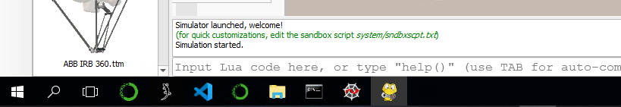
Start-up – Control panel window
Control panel window will be appeared after running the program
After switching to the V-REP, the control panel window will be hidden
Click the Control panel window icon to open it.
Click this icon

Slide 10
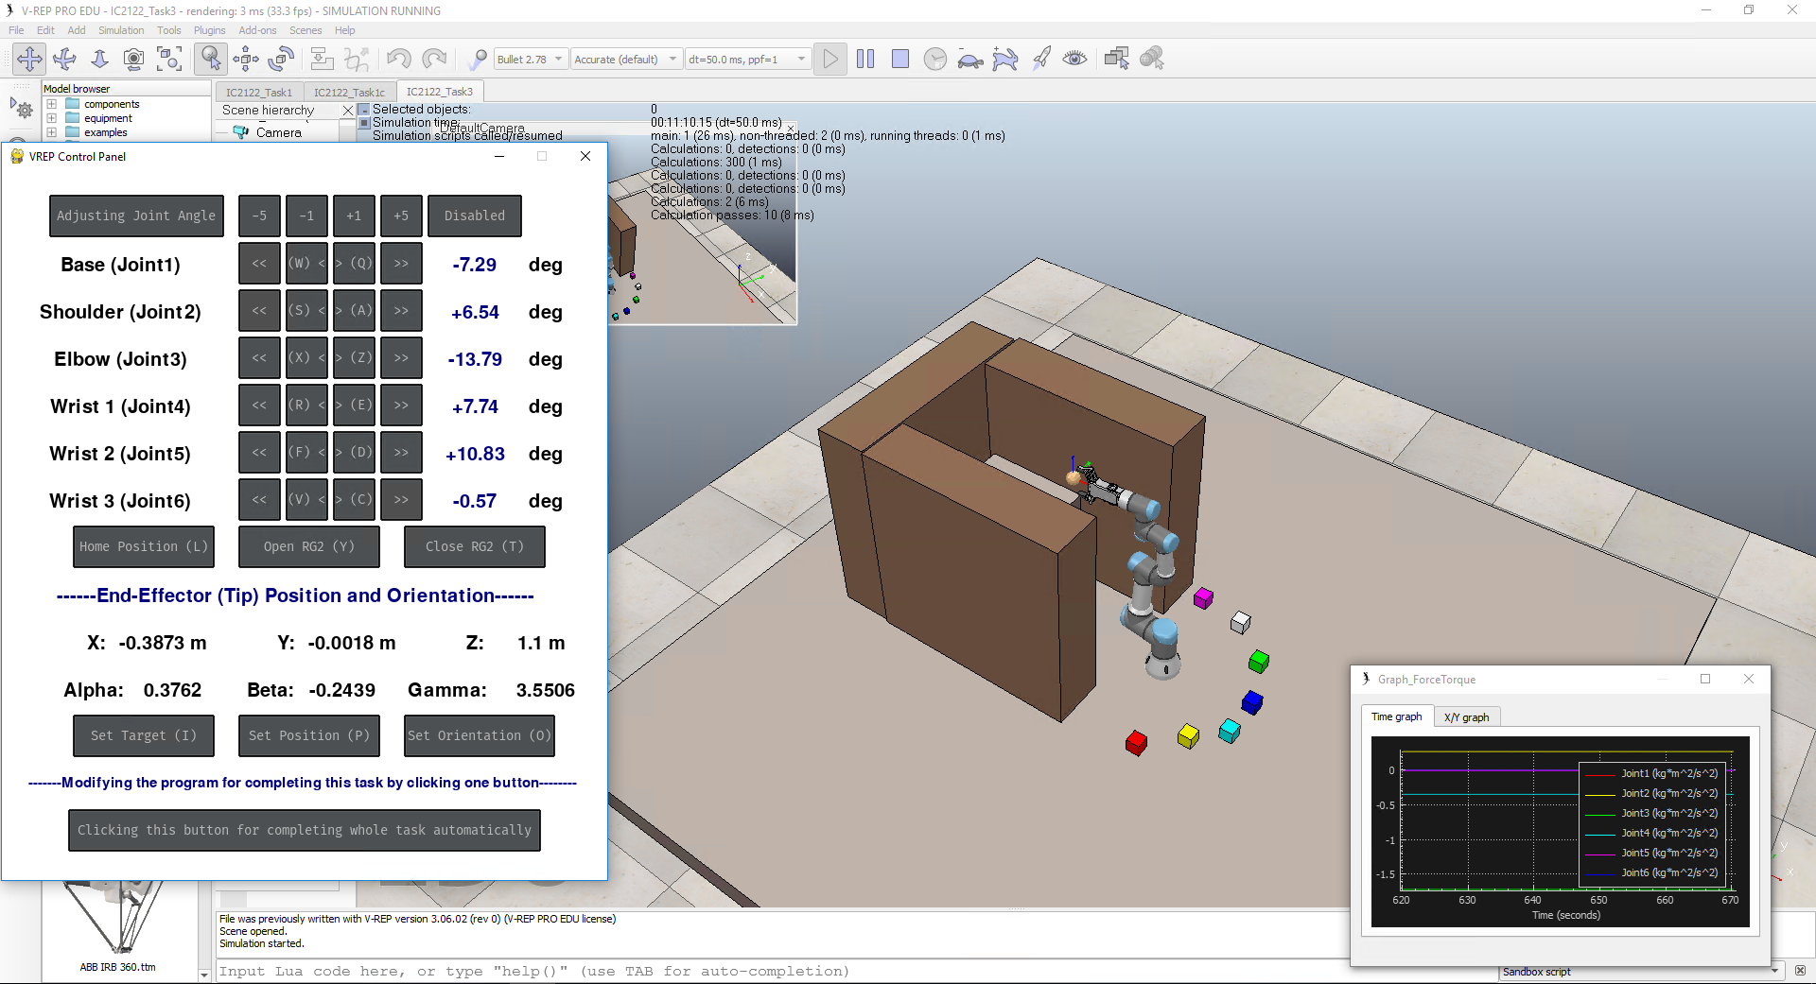
V-REP interface
V-REP interface :

Slide 11
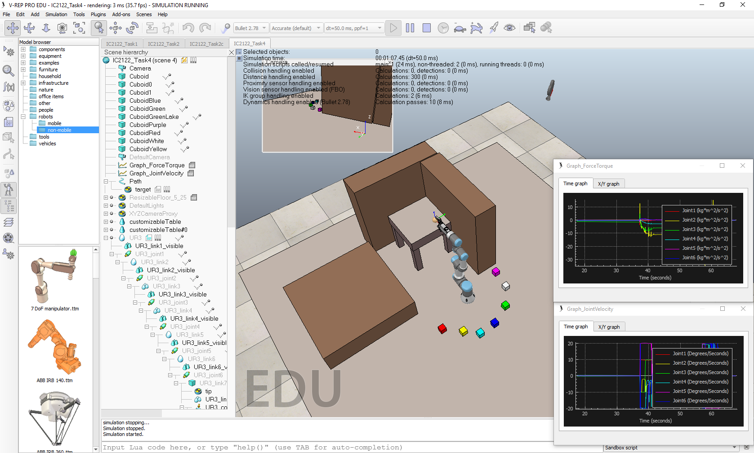
IC2122 – Task 3 remark
Remarks:
No collisions accepted
(both blocks and walls)
Cannot move the blocks via V-REP tools

Slide 12

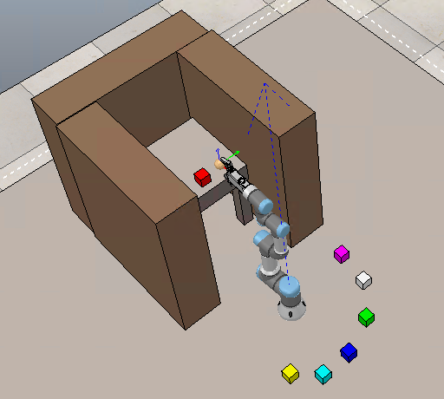
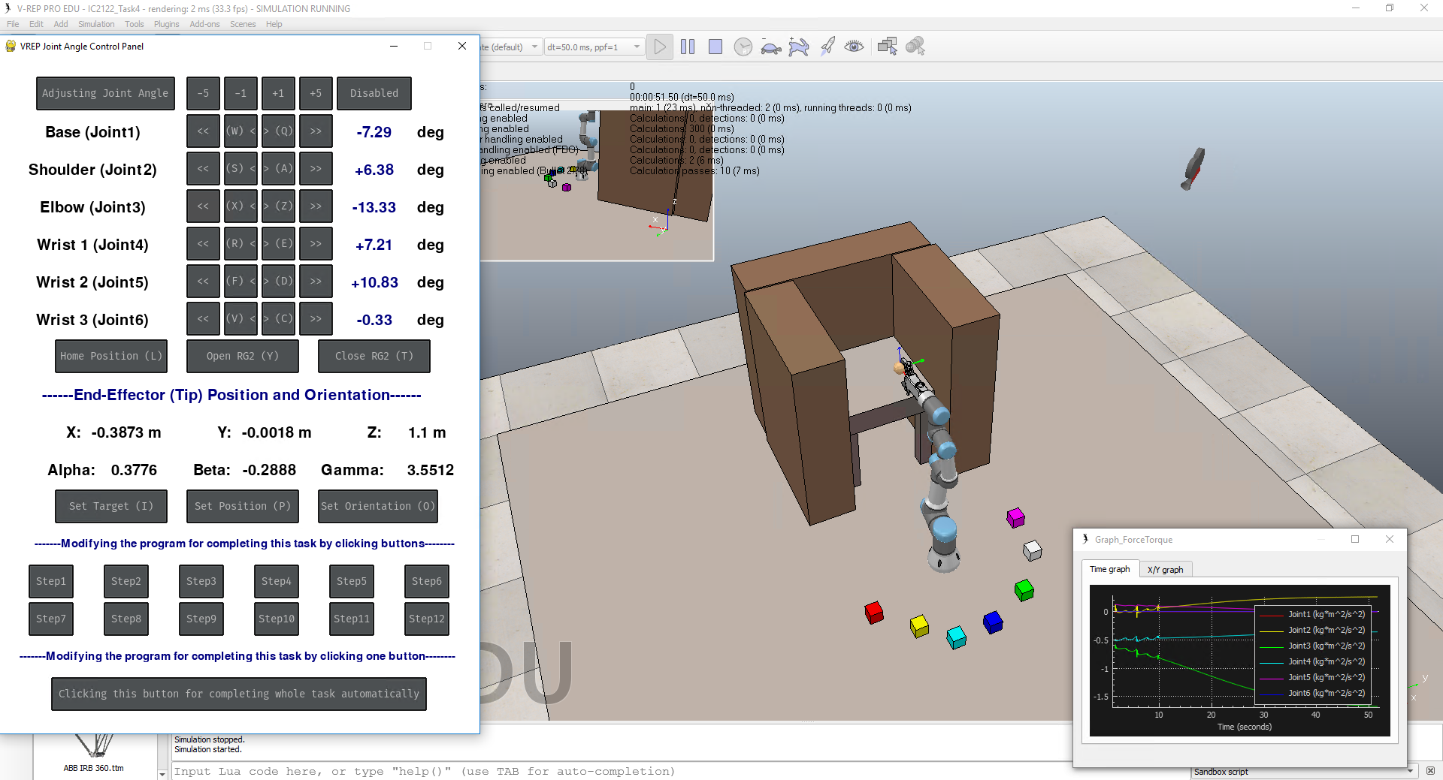
IC2122 – Task 3a
Task 3a: Assume there is a collaborative robot working in the factory. These color blocks are the materials that are required to process.
Pick the RED block and Place it on the table using Inverse Kinematics for processing and write down the procedure. (Return to the home position at the final step)
(Remark: Without any collision with other objects)
(Using below button to complete this task)
Final Goal
RED Block original Position: | Position X | Position Y | Position Z
 | 0.125 m | -0.35 m | 0.435 m
RED Block final Position: | Position X | Position Y | Position Z
 | ≈ -0.667 m | ≈ 0 m | 0.846 m

Slide 13
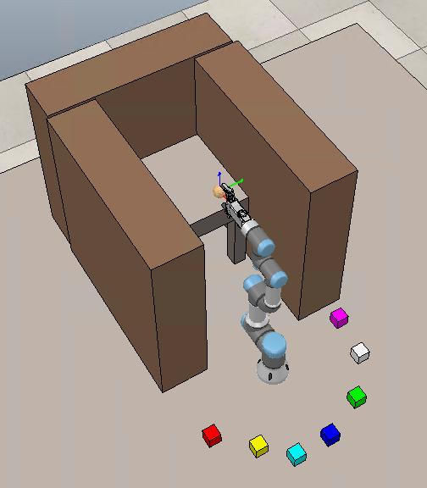
IC2122 – Task 3b
Task 3b: Continuing with part a, the process of material (RED block) is finished. It is required to place in the original position.
Pick the RED block and Place it on the original position using Inverse Kinematics and write down the procedure. (Return to the home position at the final step)
(Remark: Without any collision with other objects)
(Using below button to complete this task)
Final Goal
RED Block original Position: | Position X | Position Y | Position Z
 | ≈ -0.667 m | ≈ 0 m | 0.846 m
RED Block final Position: | Position X | Position Y | Position Z
 | 0.125 m | -0.35 m | 0.435 m

Slide 14
IC2122 – Task 3c
Task 3c: Modify the program and click “Clicking this button for completing whole task automatically” button to complete the whole process automatically. Write down the procedure and explain your program.
Pick the RED block and place it on the table
Return to the Home Position
Pick the RED block from table and place it on the original position
Return to the Home Position
(Remark: Without any collision with other objects)
RED Block (table) Position: | Position X | Position Y | Position Z
 | ≈ -0.667 m | ≈ 0 m | 0.846 m
RED Block original Position: | Position X | Position Y | Position Z
 | 0.125 m | -0.35 m | 0.435 m

Slide 15
IC2122 – Task 3c
Task 3c:
Modify the Task3.py (Path: D:\01-Home\IoT\IC2122-Robotics\Task3\Task3.py)
Example:
Move the end-effector to position (0.2,-0.2,0.6)
movement.setTargetPosition_withoutInput(0.2,-0.2,0.6)
Configure the end-effector’s orientation (0,90,-90)
movement.setTargetOrientation_withoutInput(0,90,-90)
# Please input the necessary command for completing this task by clicking one button
if event.user_type == pygame_gui.UI_BUTTON_PRESSED:
if event.ui_element == complete_button:
# Please input your command (functions can be found at Task3.py, Movement.py, Information.py )
print("Working........")

Slide 16
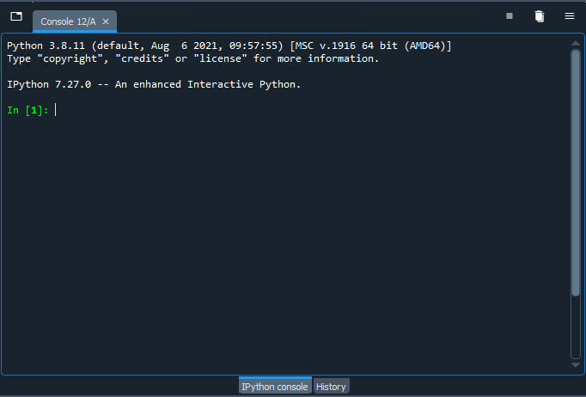
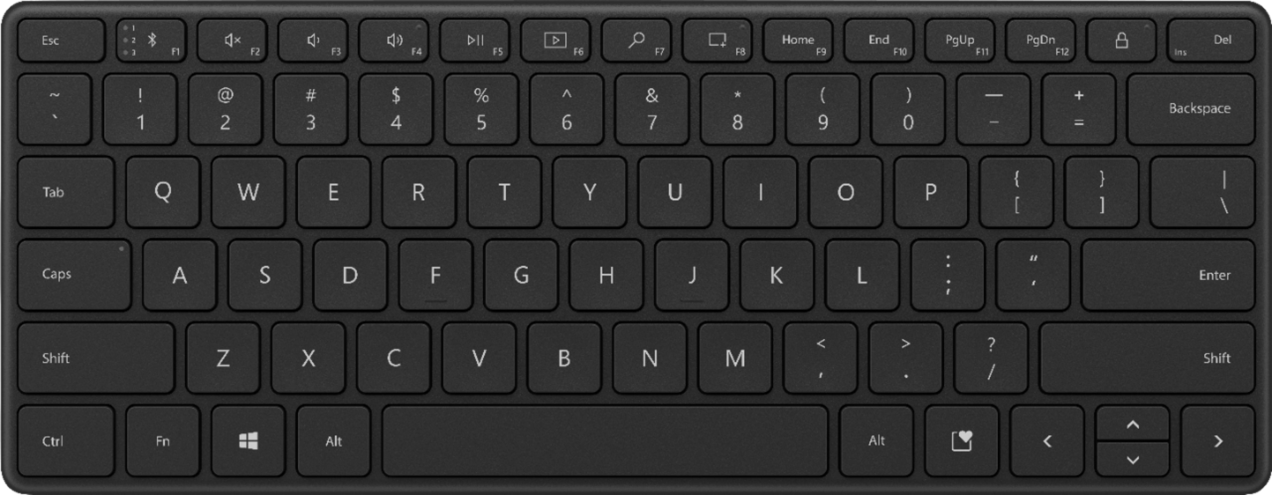
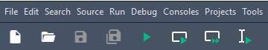
Task3 – Troubleshoot
Step 1: Switch to the Spyder IPython Console
Step 2: Stop the program by holding “Ctrl” and clicking “C”
Step 3: Open a new console by holding “Ctrl” and clicking “D”
Step 4: Stop the V-REP simulation
Step 5: Run the program at Spyder
Step 1
Step 3
Step 2
Step 4
Step 5

Slide 17
Q&A

